Slide 1


A Virtual Baby Shower for
July 1, 2020
A little cutie is on the way!

Slide 2
A Quick Toast

Slide 3

Toast content here

Slide 4
Game Time!

Slide 5
Name That Baby

Slide 6

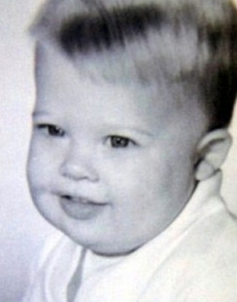
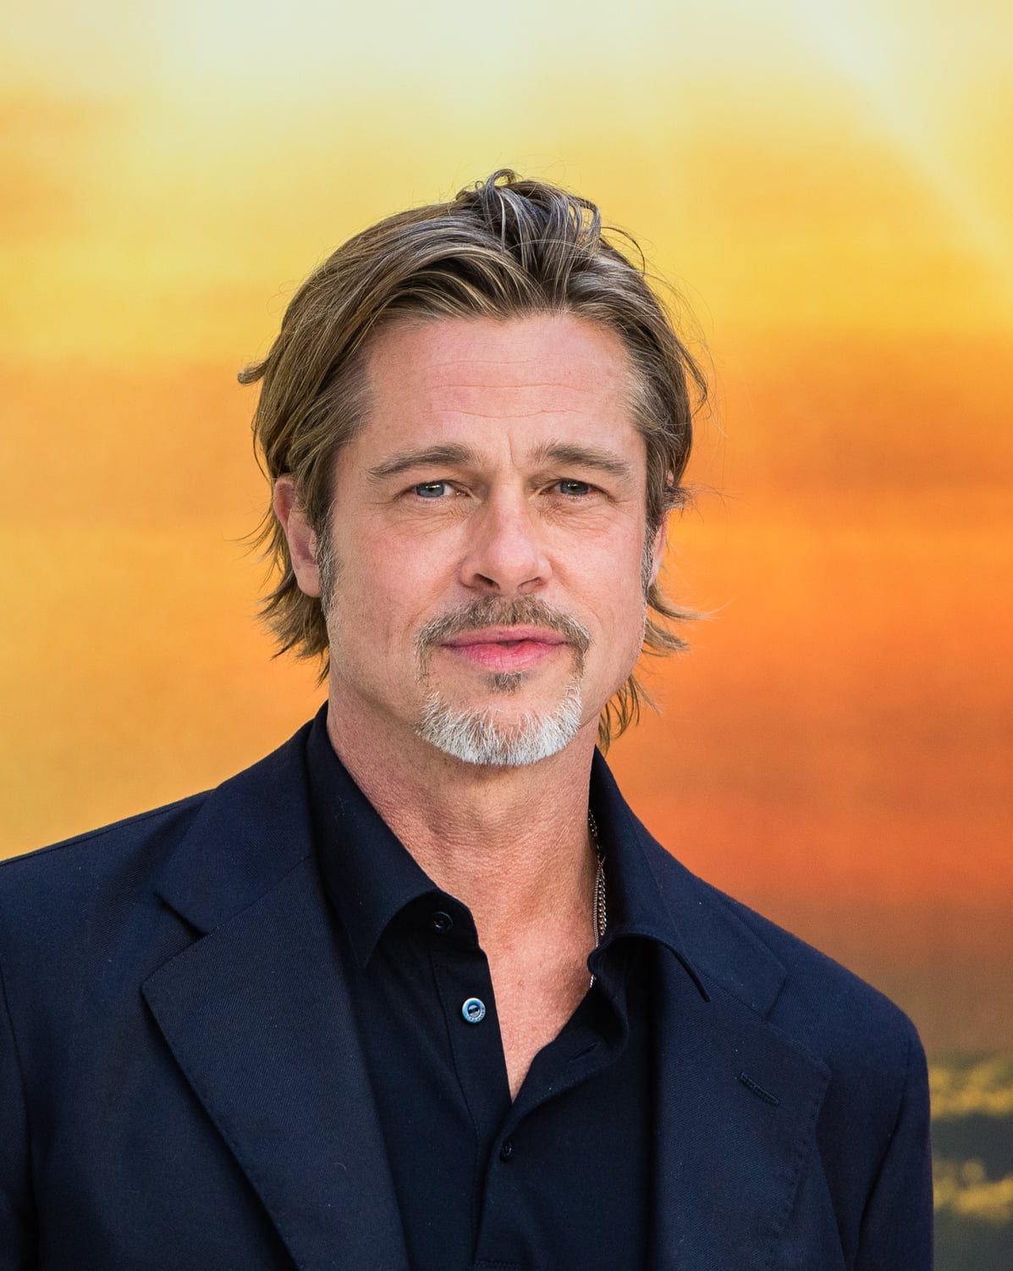
Clue #1: He’s an actor
Clue #2: He has six kids, three of them adopted
Brad Pitt

Slide 7
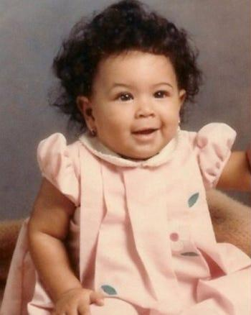
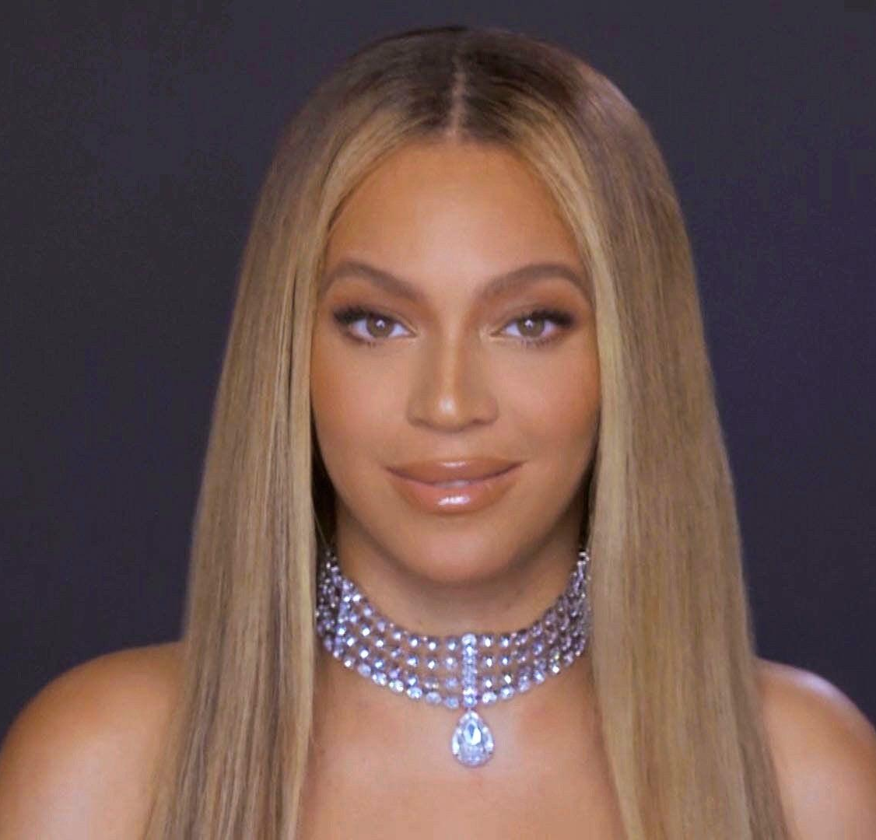
Clue #1: She was part of a girl group
Clue #2: She’s married to a rapper
Beyoncé

Slide 8
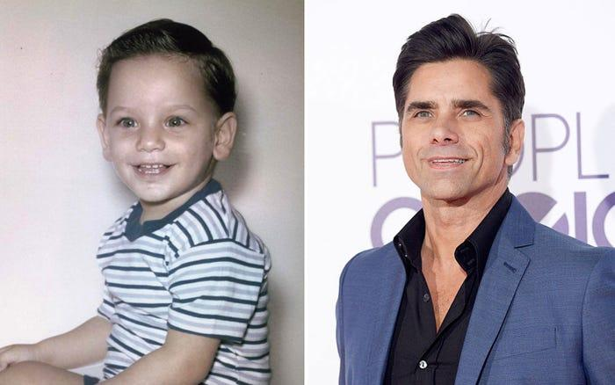
Clue: He played an uncle on a popular 90’s TV show
John Stamos

Slide 9
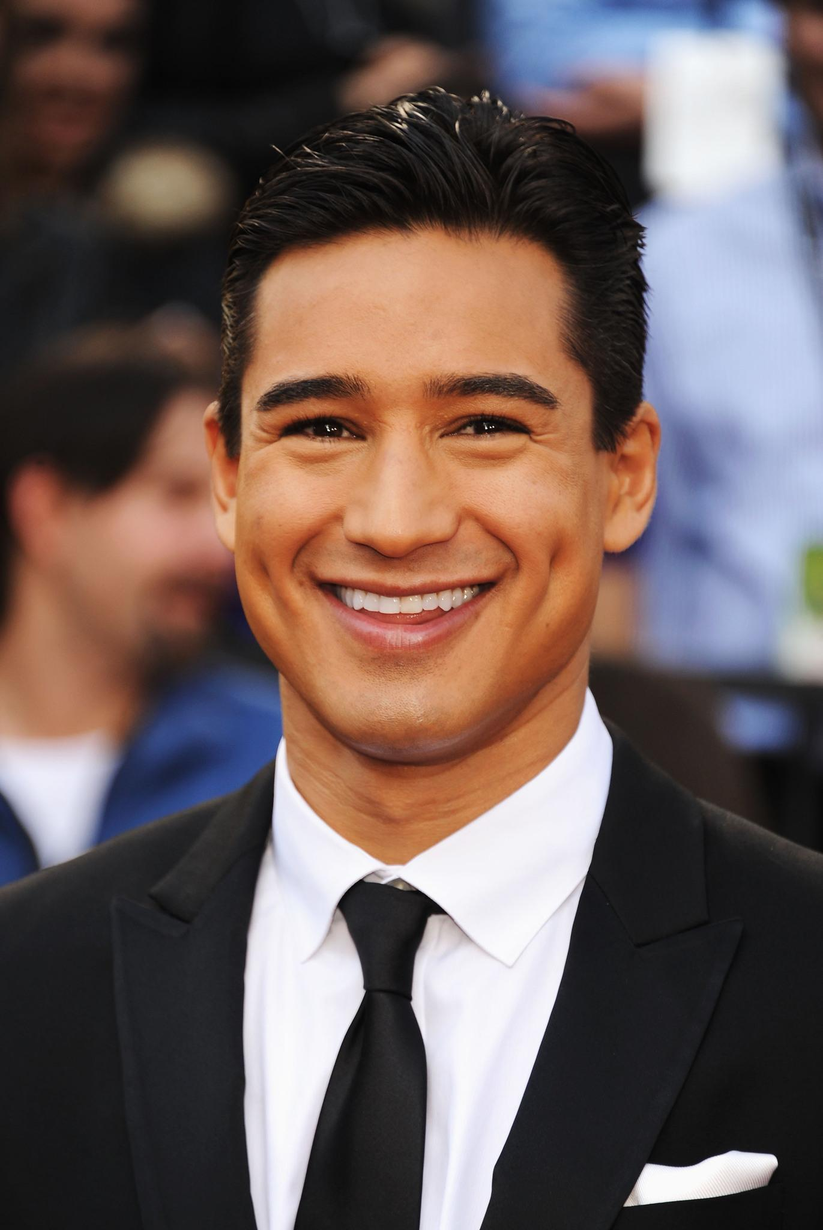
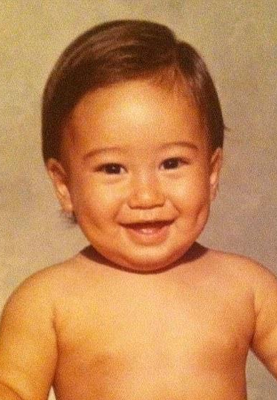
Clue: He’s an actor and TV host
Mario Lopez

Slide 10
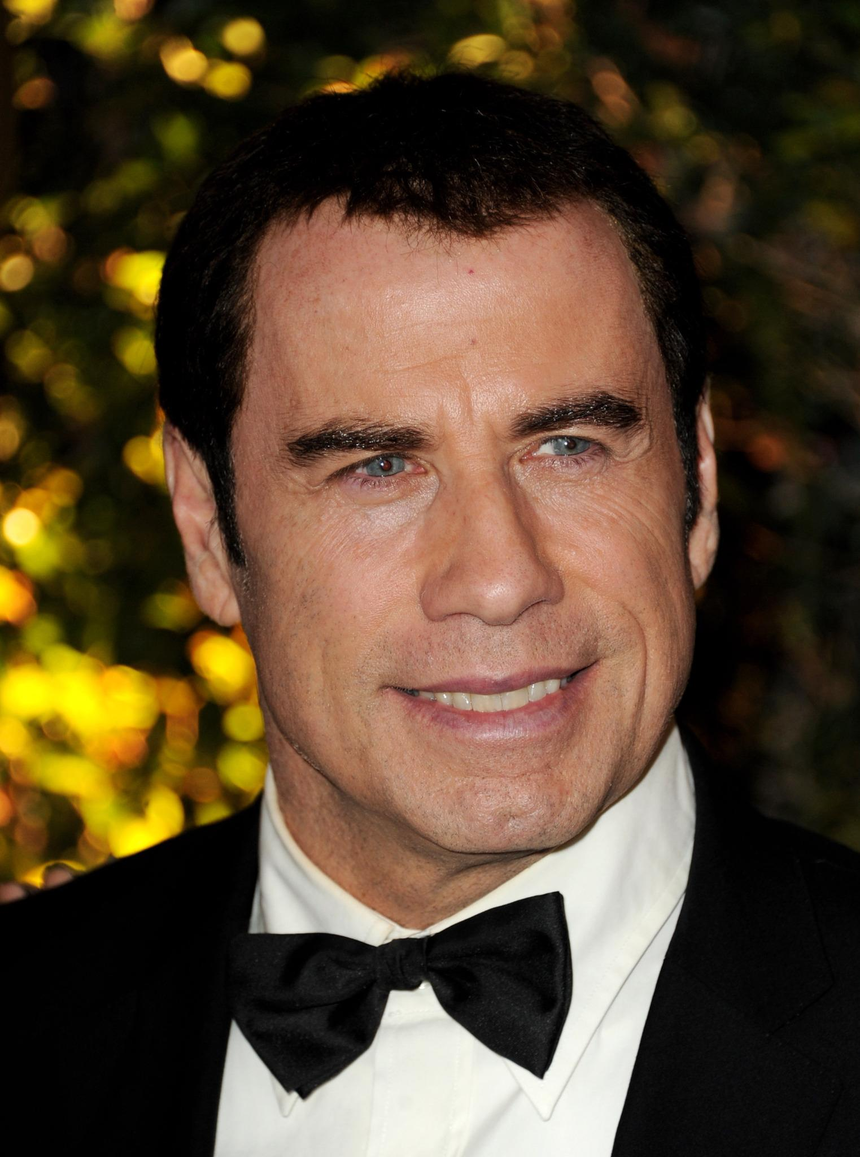
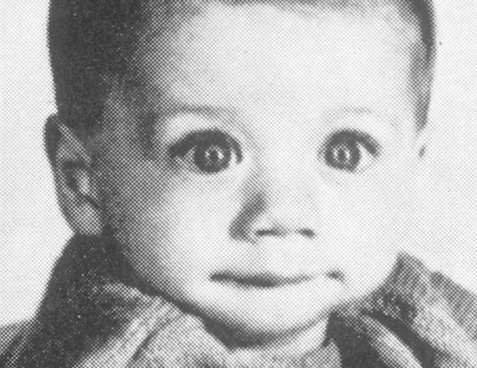
Clue #1: He’s an actor/singer/dancer
Clue #2: He had a “fever”
John Travolta

Slide 11
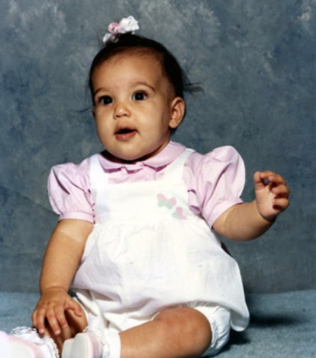
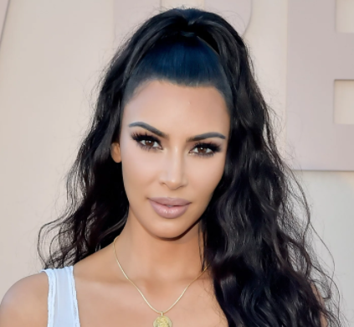
Clue #1: It’s hard to keep up with her
Clue #2: She’s famous for her ASSets
Kim Kardashian

Slide 12
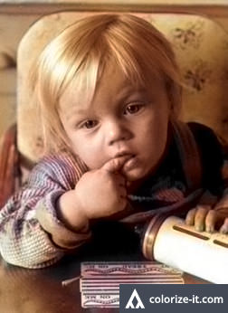
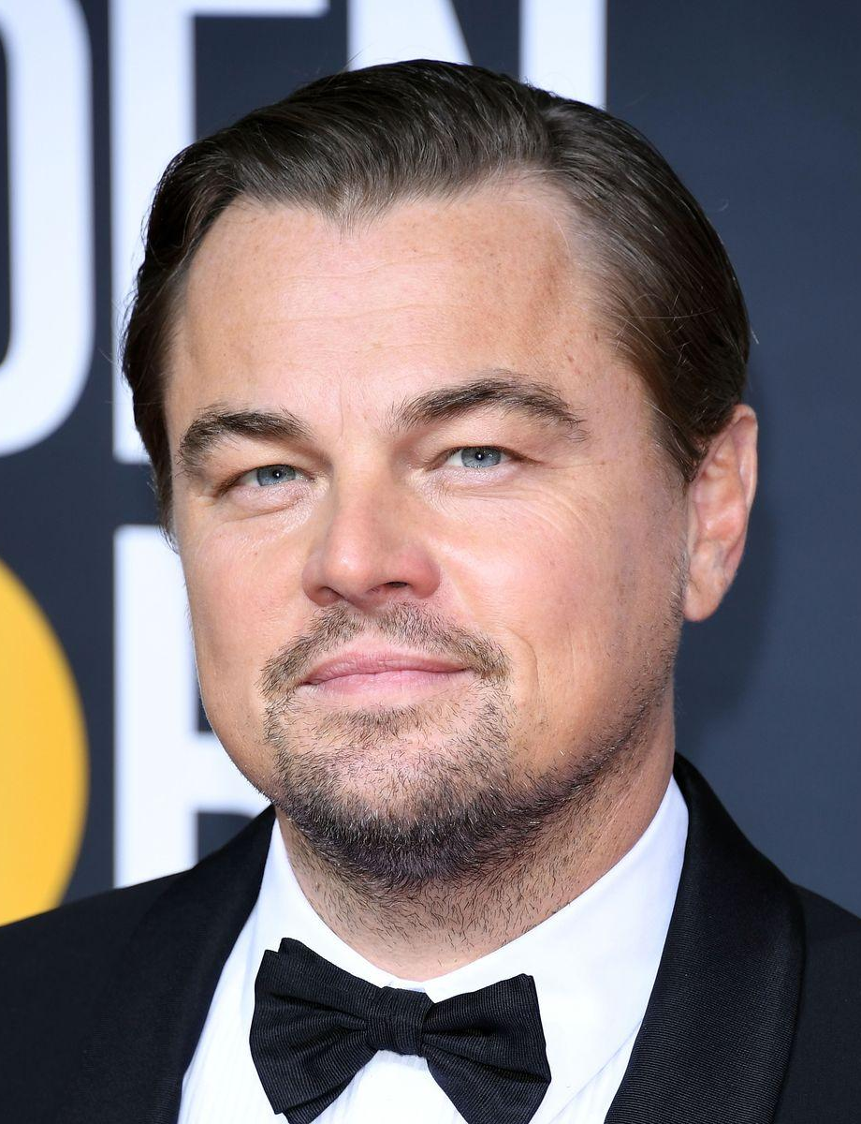
Clue #1: He doesn’t like bears
Clue #2: He doesn’t like boats either
Leonardo DiCaprio

Slide 13
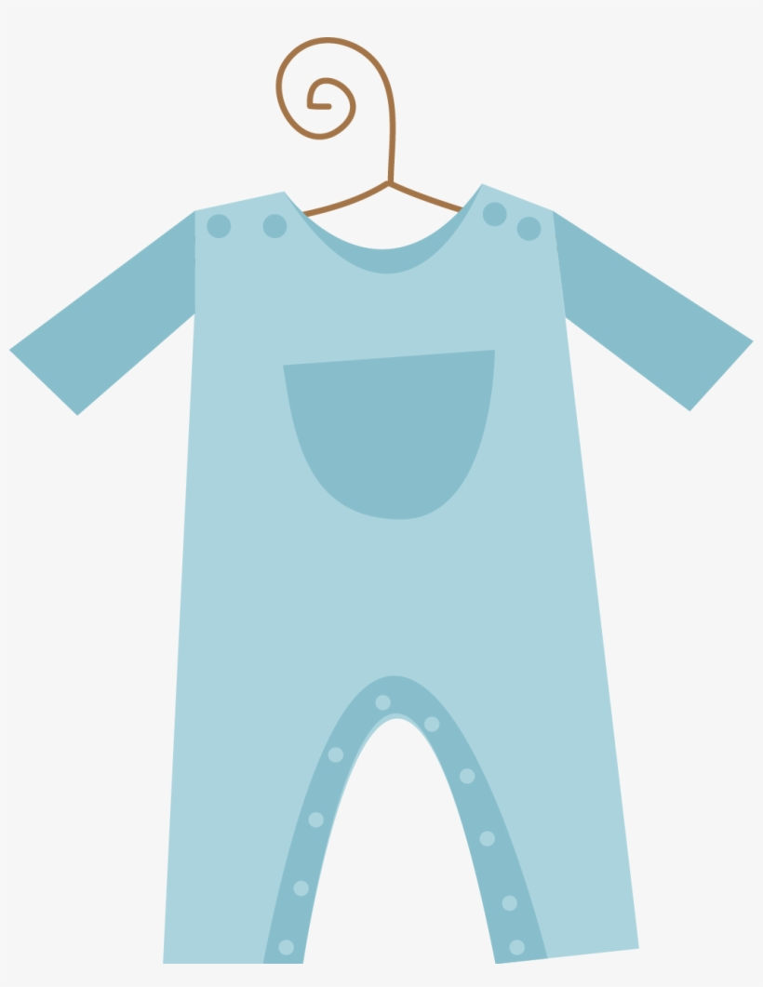
Any words of advice for a second-time mom?

Slide 14
Game Time!

Slide 15

What’s in my diaper bag?

Slide 16
Randomly-generated order:
<guest name>
<guest name>
Take turns guessing baby items that I have in my diaper bag.
If your guess is wrong, you’re eliminated.
Last one standing wins!

Slide 17


START

Slide 18
Thanks everyone for joining!
The little cutie will be here before we know it!

